Slide 1

CLASS 3: INTRODUCTION TO CSS

Slide 2
What is CSS ?
CSS (Cascading style Sheets) styles HTML elements ➡️ controls visual presentation (colors, layout, fonts)
Why CSS Matters ?
Consistency: Style entire websites from one file
Efficiency: Change design globally in seconds.
Responsiveness: Adapt layouts for mobile/desktop
Creative Control: Precise positioning and effects/
“If HTML is a house’s frame, CSS is the paint, furniture, and lighting.”

Slide 3
3 Methods to add CSS:
Linking CSS to HTML
Method | How to use | Use case
External CSS | <link href=“styles.css” rel=“stylesheet”> in the head tag | Best practice (reuseable across pages).
Internal CSS | <style></style> in the head tag | Single page projects.
Inline CSS | <h1 style=“color: red;”>A text</h1 | Avoid (mixes structure / style).

Slide 4
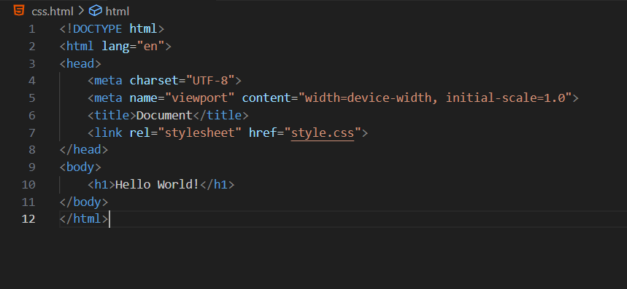
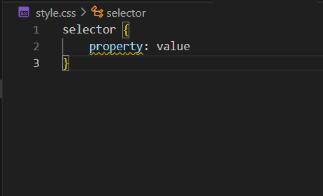
Example (External CSS):
Linking CSS to HTML

Slide 5
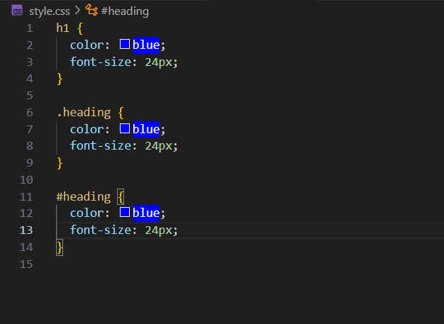
Example (External CSS):
Selector: Targets HTML element(s) (e.g. h1, class, #id).
Declaration Block: { } contains styling rules.
Property: Aspect to change (e.g., color, font-size)/
Value: Specific setting (e.g., blue, 24px)
Linking CSS to HTML

Slide 6
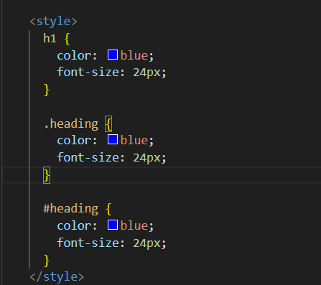
Example (Internal CSS):
Selector: Targets HTML element(s) (e.g. h1, class, #id).
Declaration Block: { } contains styling rules.
Property: Aspect to change (e.g., color, font-size)
Value: Specific setting (e.g., blue, 24px)
Linking CSS to HTML

Slide 7
Example (Inline CSS):
Property: Aspect to change (e.g., color, font-size)
Value: Specific setting (e.g., blue, 24px)
Linking CSS to HTML

